Slide 1
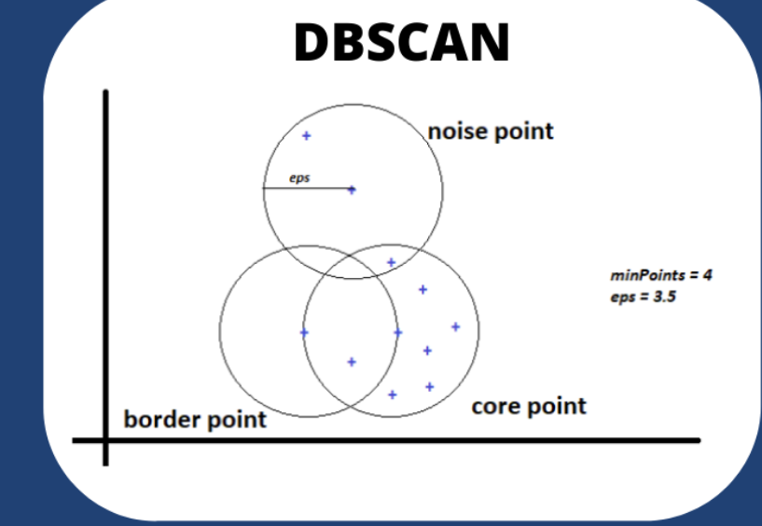

Slide 2
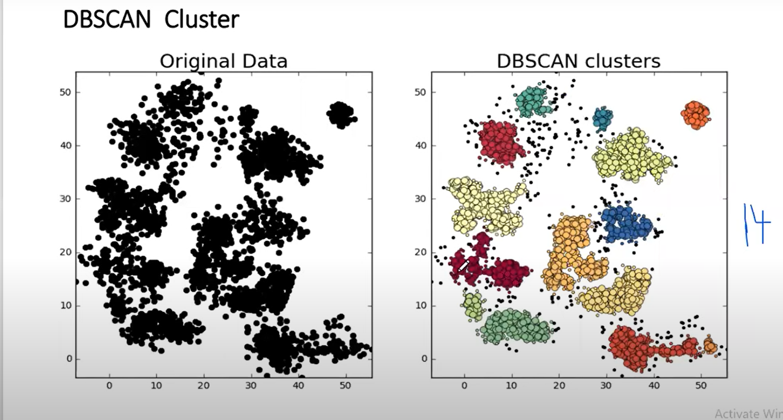

Slide 3
 | DBSCAN | k-means Clustering
Type of Algorithm | Density-Based | Centroid-Based
Cluster Shape | Can discover clusters of arbitrary shape | Assumes clusters as spherical or isotropic
Number of Clusters | Automatically determines the number of clusters | Requires the number of clusters as input
Outlier Handling | Can handle outliers effectively | Treats outliers as noise or assigns them to the nearest cluster
Scalability | Suitable for large datasets and high-dimensional data | Sensitive to the curse of dimensionality
Interpretability | Provides less interpretable cluster boundaries | Provides interpretable cluster centroids
Parameter Selection | Requires tuning of parameters like epsilon (neighborhood distance) and minPts (minimum number of points) | Requires specifying the number of clusters
Robustness | Robust to varying cluster densities | Sensitive to initial random centroid selection

Slide 4
DBSCAN | K-Means
In DBSCAN we need not specify the number of clusters. | K-Means is very sensitive to the number of clusters so it need to specified
Clusters formed in DBSCAN can be of any arbitrary shape. | Clusters formed in K-Means are spherical or convex in shape
DBSCAN can work well with datasets having noise and outliers | K-Means does not work well with outliers data. Outliers can skew the clusters in K-Means to a very large extent.
In DBSCAN two parameters are required for training the Model | In K-Means only one parameter is required is for training the model

Slide 5
Density-Based Spatial Clustering Of Applications With Noise (DBSCAN)
بشكل عام، DBSCAN هو خوارزمية قوية لتجميع البيانات المكانية ولها تطبيقات في مجالات مختلفة، مثل تجزئة العملاء، تجزئة الصور، اكتشاف القيم الشاذة، وأكثر من ذلك.
تصنيف الحيوانات والنتجات وغيرها
يهمتا المينمم بوينت والابسليون

Slide 6
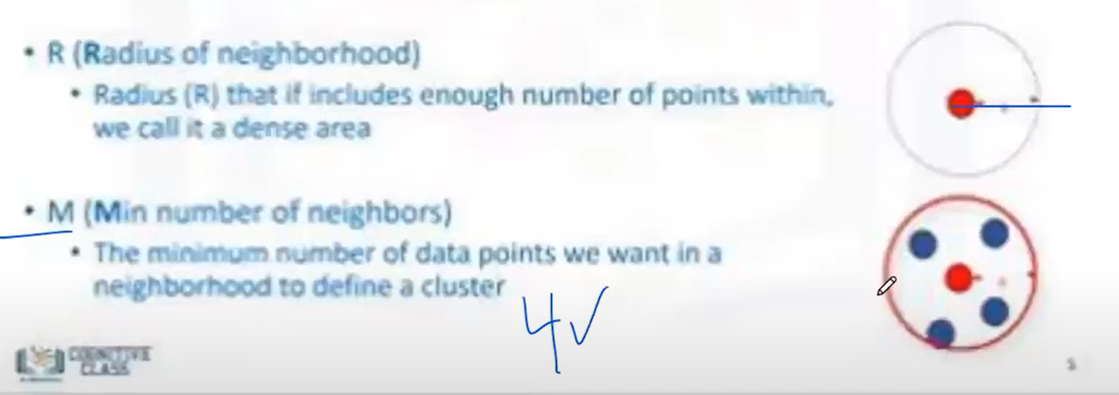

Slide 7
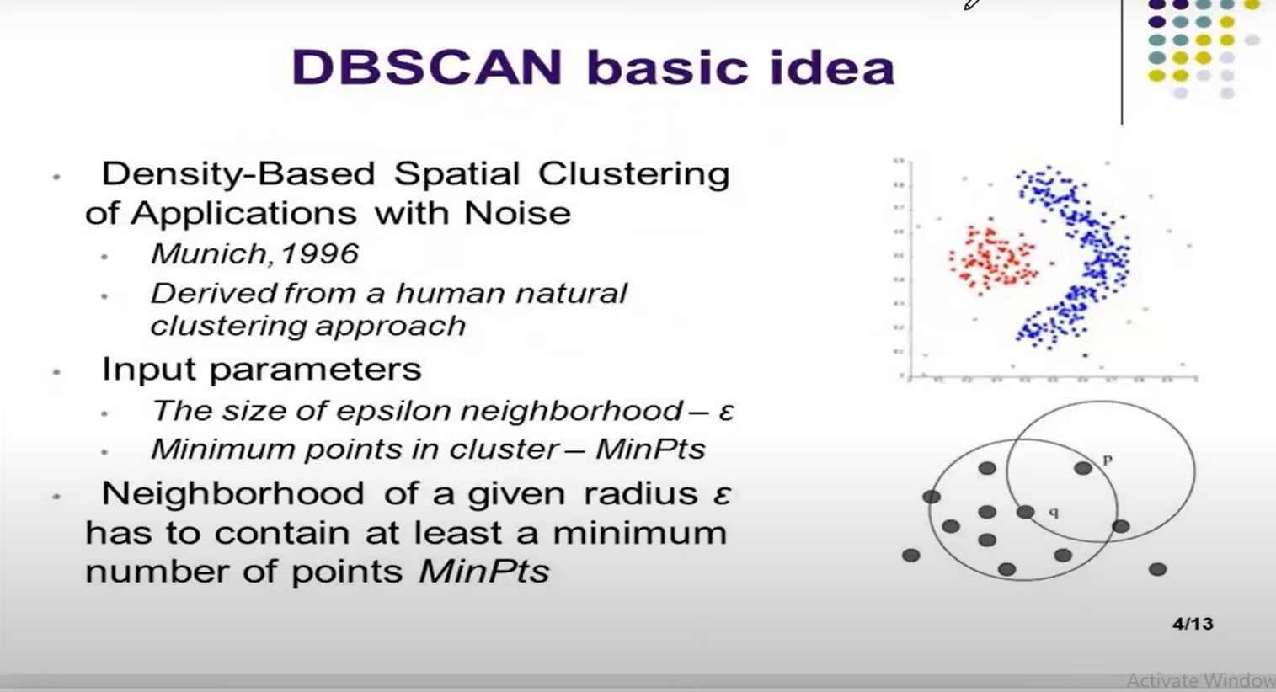

Slide 8
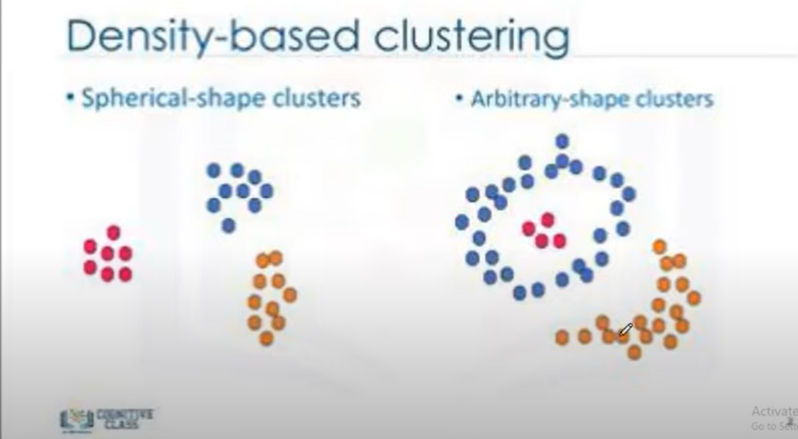

Slide 9
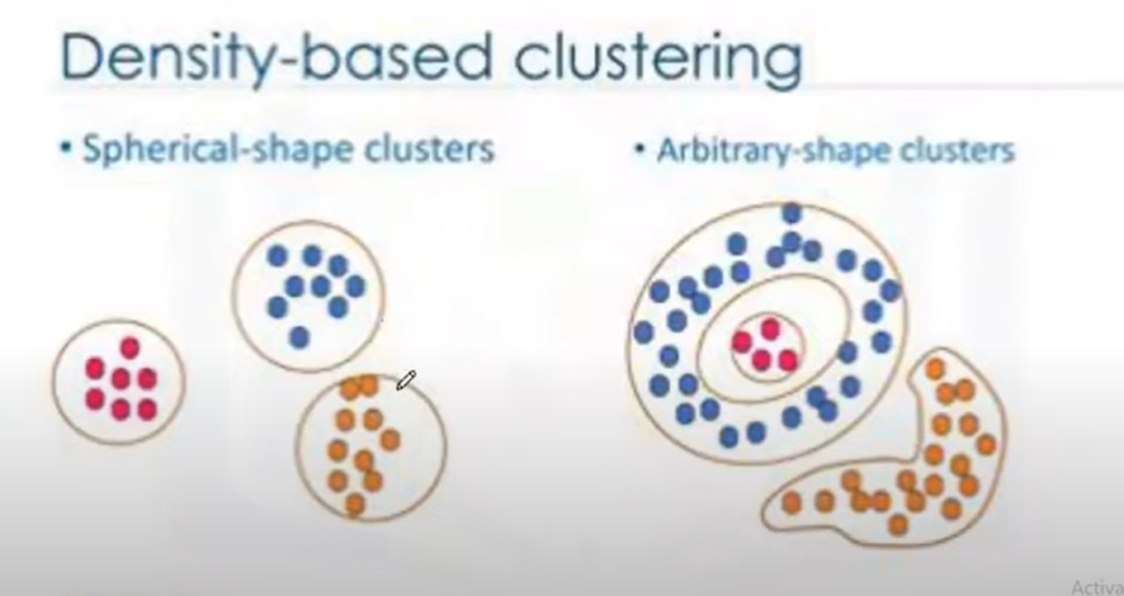

Slide 10
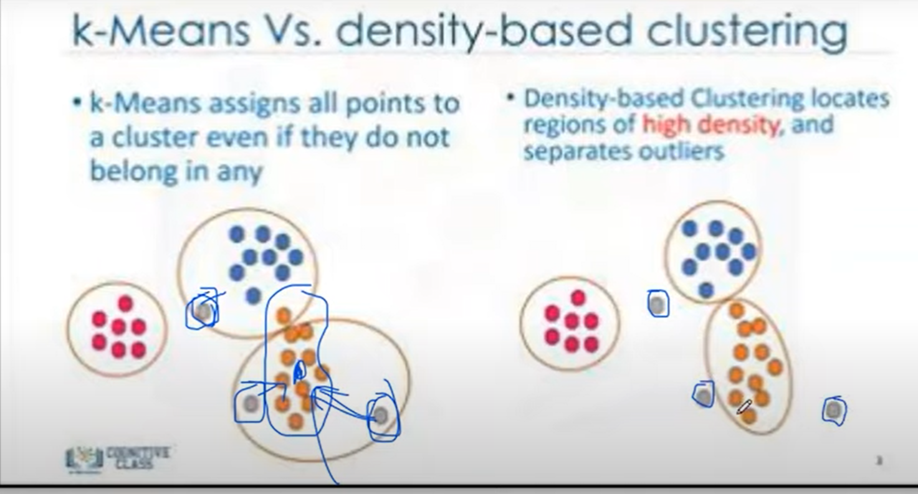

Slide 11
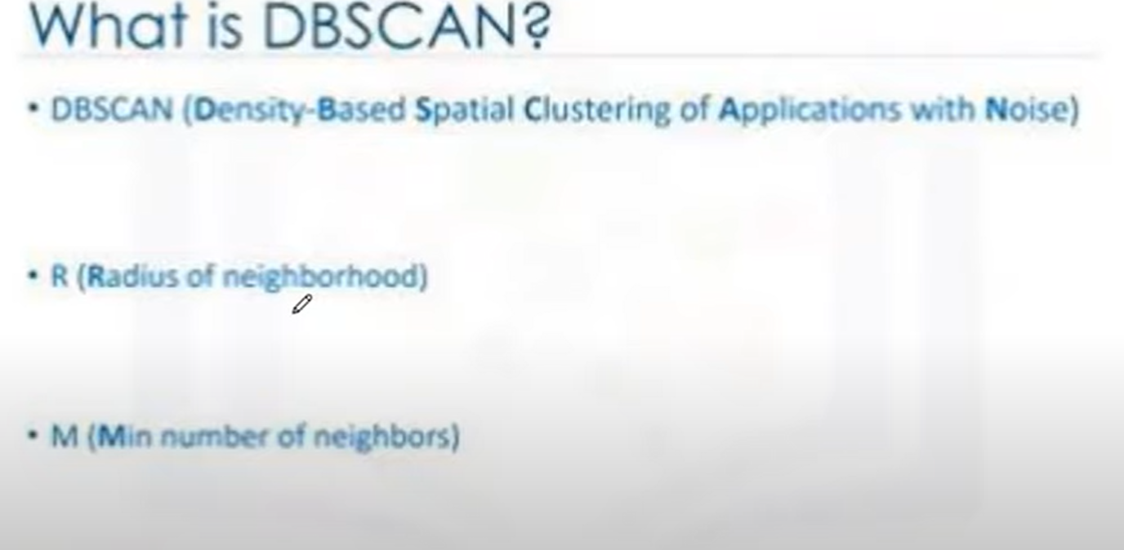
ابسليون
مين مم سوبرت

